Slide 1

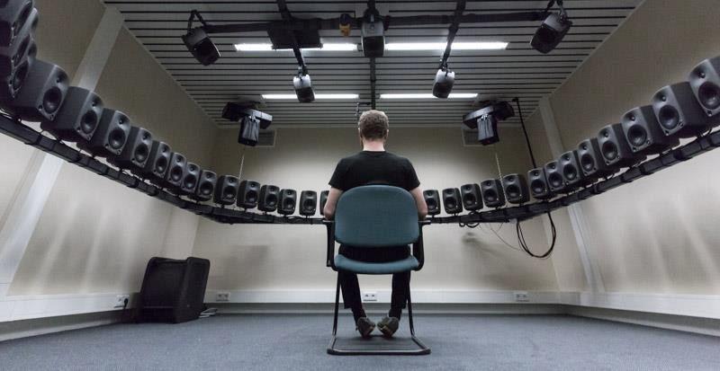
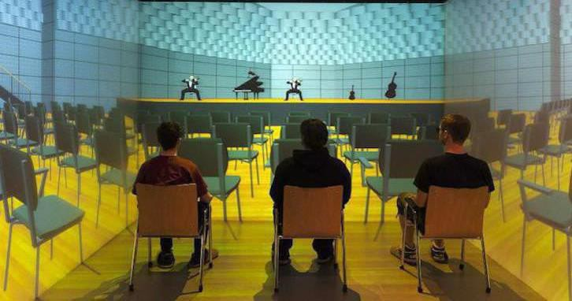
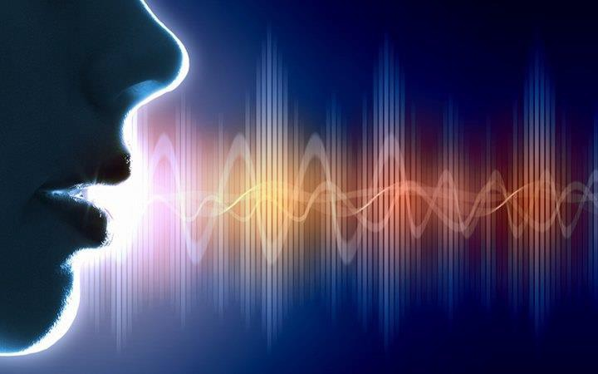
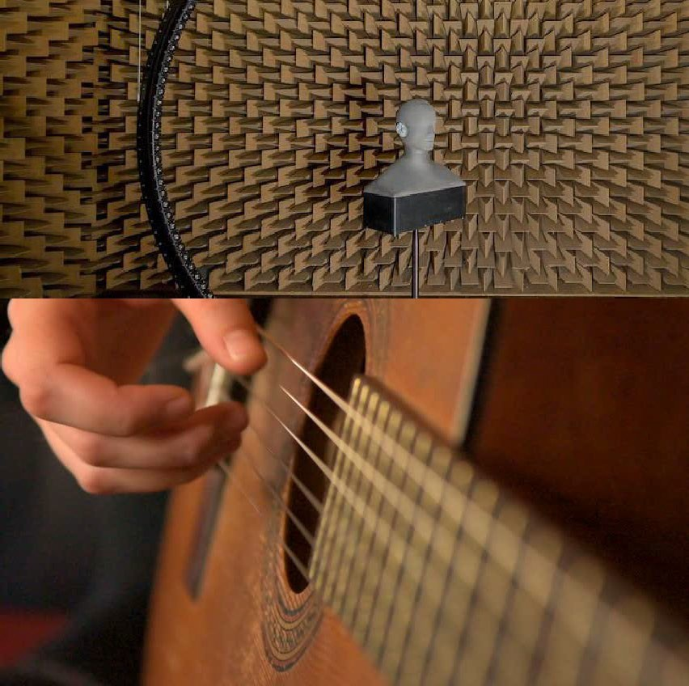
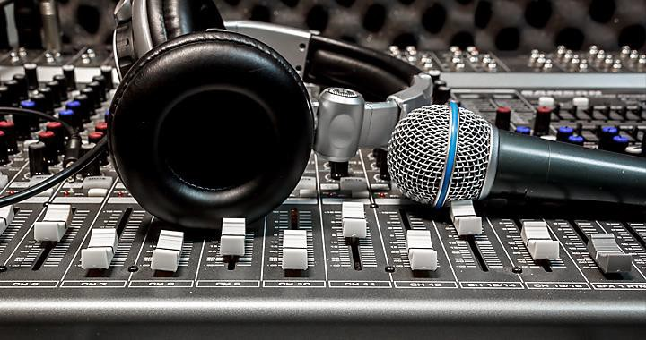
The Science of Sound
Module 2
Acoustic Communication Demonstrations
Tanmayee Pathre (t.u.pathre@tue.nl)
Building Acoustics Group
Pictures from Google

Slide 2
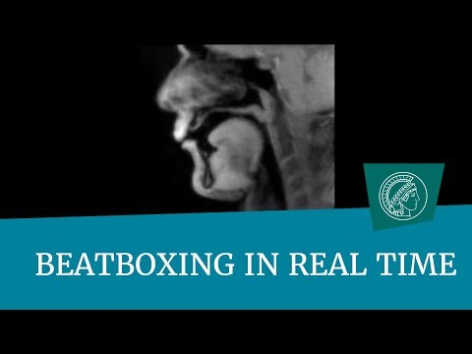
Co-articulation
Beat boxing
https://www.youtube.com/watch?v=Wh4aEc4yPh0
Source: YouTube

Slide 3
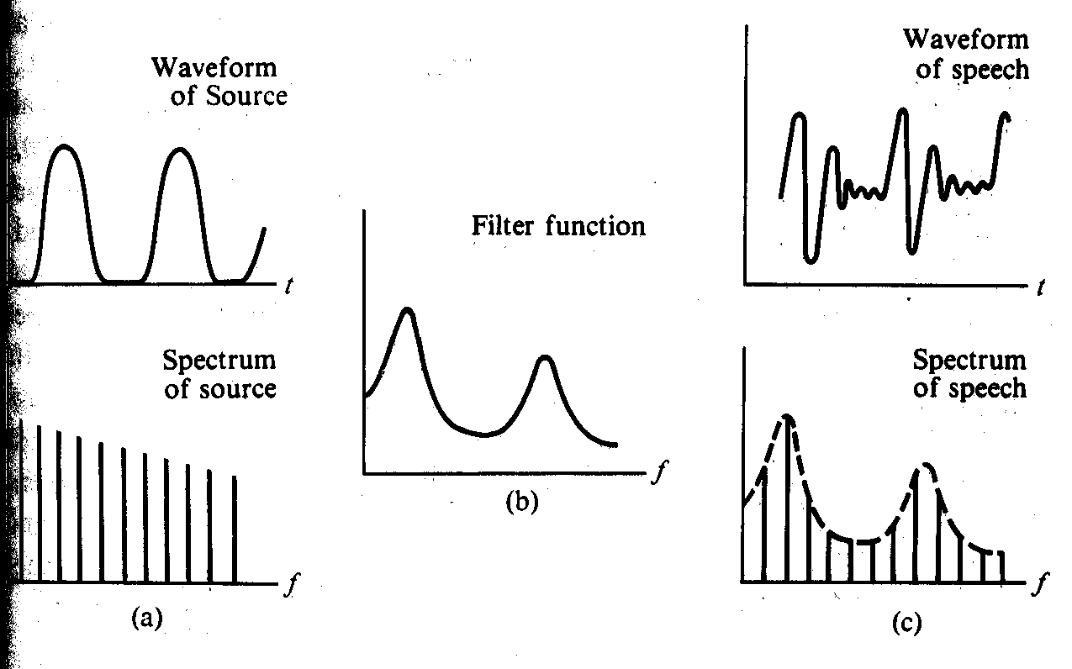

Human Vocal Organs
Source Filter Model - Demonstration
http://www.splab.net/APD/G500/index-e.html

Slide 4
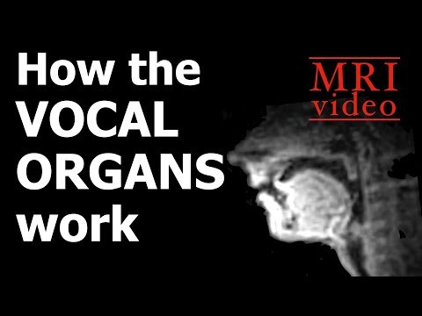
Vocal Organs
How our vocal organs work?
https://www.youtube.com/watch?v=SVKR3ESdAk8

Slide 5

Speech Synthesis
Speech Synthesis - Example
Google Cloud – Text-to-speech
https://cloud.google.com/text-to-speech/docs/create-audio
Train Announcement (in Swedish)

Slide 6
Speech Re-synthesis
Linear Prediction of Speech- Demonstration
man A (sleutel)
original
resynthesis
man B (beeldversterker)
original
resynthesis
woman C (liter melk)
original
resynthesis

Slide 7
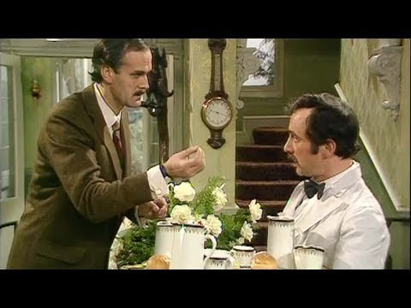
Speech Intelligibility
Misheard lyrics in song, misheard words in language
There's a bathroom on the right – is a mishearing of "There's a bad moon on the rise" from the old Creedence Clearwater song "Bad Moon Rising." (More examples and info at http://www.kissthisguy.com/
Beautiful people…look at the dinosaur → Beautiful people…Drop top, designer clothes by Ed Sheeran
https://www.youtube.com/watch?v=H-oH-TELcLE

Slide 8
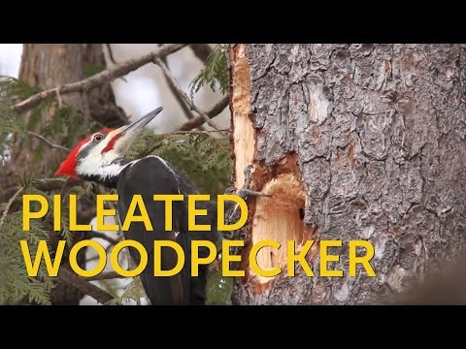
Animal communication
Sound Generation - Demo
Different ways to generate sounds - Vibration generation by drumming on external surface
https://www.youtube.com/watch?v=vGPHIM7VaTE

Slide 9

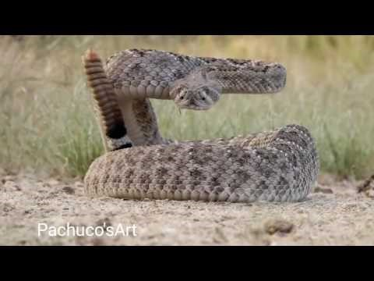
Animal communication
Sound Generation - Demo
Different ways to generate sounds - Vibration generation by drumming on external surface
https://www.youtube.com/watch?v=o42C6ajjqWg

